Slide 1
Cleaning Data Using SQL
Jeremy Bergmann - Omaha Data Science Academy

Slide 2
What is the need for data manipulation?
Creating new datasets & Combine disparate data sets
Perform common queries, aggregations, and joins
Adding, removing, or modifying data
Extracting and Storing Data
Creation/Extraction
Transformation data
Cleaning data
Storage & Retrieval
Notes:
Creation: creating tables and databases, the things
Storage: where data are stored
Cleaning: adding, removing, or modifying data
Retrieval: selecting only the data you want

Slide 3
Project Milestones
Import data into MySQL database (Class 1)
Query Data for Data Understanding/Relevant Information (Class 2)
Storing/Joining data for analysis (Class 3-4)
Cleaning Data (Class 5)
Normalize Data & Create Data Model (Class 6)
Analyze Data Quality & Create Data Dictionary (Class 7)
Connect Data to PowerBI Desktop/Cloud, Answer Business Questions Automate data workflow using ETL (Python - Optional) (Class 8)

Slide 4

Class Project
Cleaning Data
The COO would like to know the volume of existing pre-orders for console games, to predict the most popular upcoming game genres. Utilize and clean the “USA Pre-Order Chart” data to answer this question.
1. Use the “USA_PreOrders_Import.sql” file to create a table populated with preorder data, in the “Class Project/Consoles” folder.
2. Create a “USA_PreOrder_Chart” view that cleans-up the following data.
Change the “N/A” values in the “Weeks to Launch” column to 30, then cast the field as an Integer
Create “Console”, “Company” and “Genre” fields from the text in “Game_Console_Company_Genre”
For 1-10, Fill-In the “Game” & “Genre” columns with relevant values
Calculate the difference between today and the date the preorder list was last published. (‘2018-12-29’)
4. Select “Genre” and “Weeks to Launch” from the view you created, then summarize by “Total”. What Genre has the top pre orders as of EOY 2018, and what genre do you think will be best in 2019?
Notes:
USA Pre-Order Chart from (29-Dec-2018): http://www.vgchartz.com/preorders/43464/USA/

Slide 5
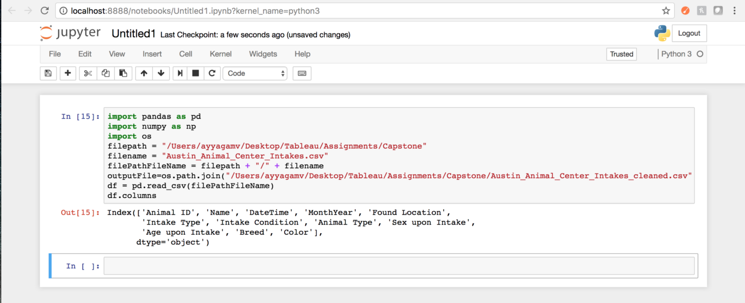
Appendix - Cleaning data: Python
Data scientists spend a large amount of their time cleaning datasets and getting them down to a form with which they can work. In fact, a lot of data scientists argue that the initial steps of obtaining and cleaning data constitute 80% of their job.
Tasks - Using Pandas Library
Dropping unnecessary columns in a Pandas DataFrame
Using .str() methods to clean columns
Using the DataFrame.applymap() function to clean the entire dataset, element-wise
Renaming columns to a more recognizable set of labels
Skipping unnecessary rows in a CSV file
Resource: Python for Data Analysis (O’Reilly)
*Cleaining Strings in python: https://mode.com/sql-tutorial/sql-string-functions-for-cleaning/
Notes:
Common ways to clean data with Python are available in the many libraries that you can import in your code. One of the most popular libraries is Pandas, which was designed for data manipulation and analysis, but is most commonly associated with data cleaning. Here is a common code snippet where Pandas is imported to clean a set of data:

